Slide 1
Ice Breaker (Transdisciplinary Theme)
How We Organize Ourselves – What is your role at Morris Brandon?
Where We Are in Place & Time – How long have you been part of the Brandon community? In what grade(s) is your child(ren)?
How We Express Ourselves – What hobb(ies) occupy you/your family’s time?
Notes:
When conducting research, it is easy to go to one source: Wikipedia. However, you need to include a variety of sources in your research. Consider the following sources:
Who can I interview to get more information on the topic?
Is the topic current and will it be relevant to my audience?
What articles, blogs, and magazines may have something related to my topic?
Is there a YouTube video on the topic? If so, what is it about?
What images can I find related to the topic?

Slide 2
Self-Study: Moving Forward as an IB PYP World School
Evaluation 2020

Slide 3
“If you don’t know where you’ve come from, you don’t know where you’re going…” ~ Maya Angelou
1947 – Morris Brandon Elementary opens.
2003 – IB PYP Candidacy Phase
2007 – Authorized as IB World School
2010 – First Evaluation visit.
2015 – Second Evaluation Visit.
Three overarching “Matters to Be Addressed”.
One overarching “Matter to Be Addressed”.

Slide 4
Outcomes of 2015 Evaluation
The school places importance on language learning (French in grades 1-5).
5th Grade Exhibition between 2010-2015.
The librarians demonstrated enthusiasm and support for the PYP through the varied resources that address different cultures and languages.
Notes:
When conducting research, it is easy to go to one source: Wikipedia. However, you need to include a variety of sources in your research. Consider the following sources:
Who can I interview to get more information on the topic?
Is the topic current and will it be relevant to my audience?
What articles, blogs, and magazines may have something related to my topic?
Is there a YouTube video on the topic? If so, what is it about?
What images can I find related to the topic?

Slide 5
Outcomes of 2015 Evaluation
Action Plan
Written Curriculum
Gifted program pre-2015
Accelerated Math program
Transdisciplinary Learning
Collaborative Planning
IB Report Card
Lack of teacher and community engagement
Notes:
When conducting research, it is easy to go to one source: Wikipedia. However, you need to include a variety of sources in your research. Consider the following sources:
Who can I interview to get more information on the topic?
Is the topic current and will it be relevant to my audience?
What articles, blogs, and magazines may have something related to my topic?
Is there a YouTube video on the topic? If so, what is it about?
What images can I find related to the topic?

Slide 6
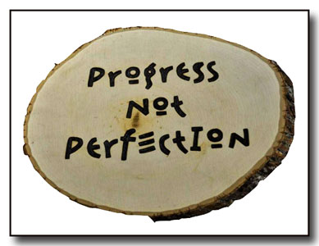
Progress since 2015 Evaluation
Action Plan
Written Curriculum
Gifted program pre-2015
Accelerated Math program
Transdisciplinary Learning
Collaborative Planning
IB Report Card
Lack of teacher and community engagement
Notes:
When conducting research, it is easy to go to one source: Wikipedia. However, you need to include a variety of sources in your research. Consider the following sources:
Who can I interview to get more information on the topic?
Is the topic current and will it be relevant to my audience?
What articles, blogs, and magazines may have something related to my topic?
Is there a YouTube video on the topic? If so, what is it about?
What images can I find related to the topic?

Slide 7
Mission / Vision Revision

Slide 8
Mission & Vision Process Timeline
August 2019
Sept. 2019
Sept./Oct. 2019
Nov. 2019
Dec. 2019
Survey emailed to teachers and community to gather input about attractive characteristics of the school
Teachers write short narrative about when they’ve done their best work and highlight causes, actions, and impacts.
VISION statement was drafted from parent input.
Teachers met to collectively create the MISSION and VALUES
Draft of revised Mission and Vision is sent to community for input.
Mission, Vision, and Values statements are finalized for January 2020 roll-out.
Your Title
Your Title
Your Title
Marketers must link the price to the real and perceived.
Marketers must link the price to the real and perceived.
Marketers must link the price to the real and perceived.

Slide 9
Mission & Vision Alignment
Morris Brandon ES (2014)
IBO (1998)

Slide 10
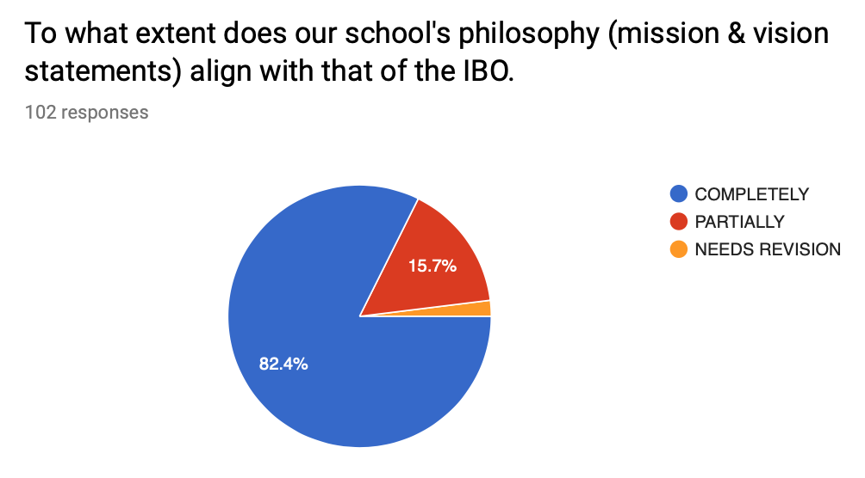
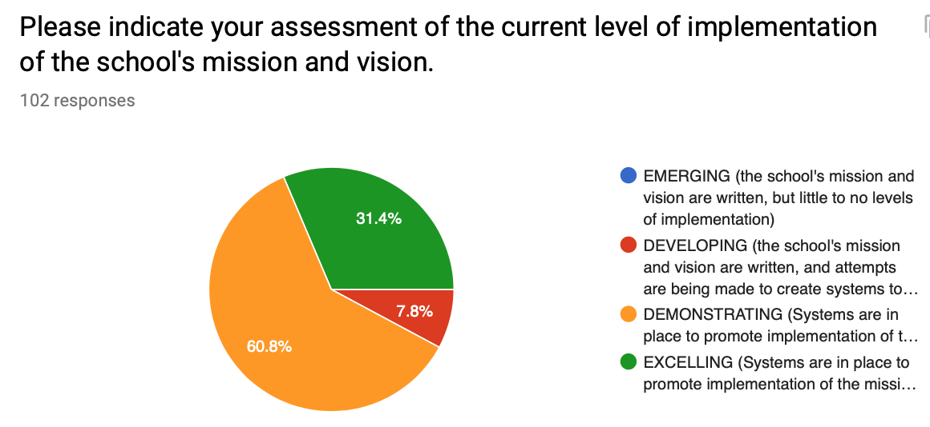
Survey Results
Morris Brandon Mission & Vision Alignment with IBO
Notes:
After consulting a variety of sources, you will need to narrow your topic. For example, the topic of internet safety is huge, but you could narrow that topic to include internet safety in regards to social media apps that teenagers are using heavily. A topic like that is more specific and will be relevant to your peers. Some questions to think about to help you narrow your topic:
What topics of the research interest me the most?
What topics of the research will interest my audience the most?
What topics will the audience find more engaging? Shocking? Inspiring?

Slide 11
Survey Results
What makes Morris Brandon attractive to students and parents?
Notes:
After you’ve done your research, it’s time to put your presentation together. The first step in the process is to introduce the topic. This is a great time to connect your topic to something that your audience can relate. In other words, why should they listen to all the information you will be sharing in your research presentation? What is in it for them? You may also want to include a graphic or image to grab their attention.
Feel free to duplicate this slide by right-clicking on this slide in the slides pane to the left and select Duplicate Slide.
The next step in your presentation is to state your claim or topic clearly. Your teacher may even call this your thesis. As you state your thesis, you may find that this layout is not the best layout for your claim or topic. You can change the layout by clicking the drop-down menu next to the Layout in the Slides menu section. You can choose Two Content, Comparison, or Picture with Caption. Note: A different layout might change the look of the icons on this page.
You will also want to state your facts. You have done the research now share some of the interesting facts with your audience. Facts do not have to be boring; you can communicate facts in a variety of ways by going to the Insert Tab. In the Insert tab you can:
Insert pictures from your computer or online.
Add a chart
Create some SmartArt
Insert a variety of icons to help your facts come to life. Note: You can change the color of the icons by selecting the icon and then click on the Format tab and then Graphics Fill. From there, you will choose a color from the list or choose More Fill Colors to give you more options.
Since this research presentation is a result of your hard work and searching, you want to make sure you support the claims or points in your presentation with facts from your research findings. Make sure you give the author proper credit for helping you share your ideas. If one of your sources has a video that is relevant to your topic, you can add the video as added support. Keep in mind the length of the video and the amount of time you have for your presentation. For a 5 minute speech, the video should be no longer than 30 seconds.
Questions to consider:
How will you state the author of the source?
Will you need to cite the source on the slide?
What are some ways you can engage your audience so they feel like they are a part of the presentation? Some ideas to consider is by taking a quick poll like: by a show of hands, how many of you think school uniforms are a way to cut down on bullying? Another suggestion is to have them hold up a certain number of fingers to see if they agree or disagree. Finally, you can share a story that the audience can relate to that makes them laugh.
After all the applause, your audience may have some questions. Be prepared to answer some of their questions by making a list of questions you think they might ask. You may also want to share the presentation with them by providing the link to your presentation, if they want more information.

Slide 12
Mission / Vision / Values (2019)
It is the MISSION of Morris Brandon Elementary to develop students’ academic, social, and emotional needs by engaging our entire school community to work collaboratively while fostering international-mindedness and a love for learning.
It is the VISION of Morris Brandon Elementary School to educate the whole child by teaching empathy, open-mindedness, compassion, and critical thinking while giving every student what they need to be successful lifelong learners.
At Morris Brandon Elementary, we VALUE:
The whole child.
Our entire global community – students, parents, staff, community members, business partners, and people outside our community.
Inquiry, creativity, critical thinking and innovation.
Learning through play.
The unique perspectives of others.
Empathy toward other peoples and cultures, and our environment.

Slide 13
Matters to Be Addressed
Action Plan

Slide 14
The Written Curriculum
Classrooms demonstrate different levels of understanding and commitment to PYP.
Few examples of transdisciplinary learning exist and vary across grade-levels.
Pull-out Gifted program follows prescriptive curriculum.
Lack of collaboration (2010 and 2015).
Schedule is divided by subject area and not conducive to transdisciplinary teaching, learning, or inquiry.
Teachers do not explain how unit planners are developed.
All units have not been documented (ManageBac); several units do not align with any Transdisciplinary Theme.
Single-subject units do not address all elements of PYP.
New faculty have received overview workshops from me.
All grade-levels were given up to 3 days of release each of the last two school years dedicated to professional learning and instructional design.
Grade-level planning times have been used to continue focused demonstrations in instructional design.
Unit planning template was redesigned and now housed for teachers to access, revise, reflect in Google Classroom; migrating to a new platform – Toddle – next school year.
Master Schedule still needs revision to show blocks of transdisciplinarity.
Single-subject teachers are now being enveloped into the grade-level units of inquiry to ensure true transdisciplinarity.
Exhibition is being revamped beginning this school year.
Almost 50% of staff are still in need of training.

Slide 15
Reporting Grades
Teachers report on student progress in the different subject areas that are not in alignment with the assessment philosophy of the PYP.
APS revamped report card to report Learner Profile attributes as conduct grades.
Some grades use SeeSaw to upload work in alignment to PYP elements for student reflection.
Migrating to Toddle to house Unit plans with learning experiences added in the design process and tagged to PYP elements for student reflection.

Slide 16
Community Engagement
School communicates philosophies, policies, and procedures to community.
Procedures are communicated at the grade-level.
Policies need revision (assessment, mission/vision) and creation (language, inclusion, academic integrity).
Stakeholders are given opportunities through forums and surveys to provide input on each of the aforementioned policies.

Slide 17
Final Stretch before Evaluation Visit
Revise Language and Inclusion policies.
Improve 5th grade Exhibition for 2019-2020 SY.
Designing new signage for the building in alignment with language policy.
Submit paperwork to IB by June 1.
Create Academic Integrity Policy.
Develop a plan for officially training faculty over the next 5 years in order of hire date and priority.

